Slide 1
Adaptive and Collaborative Edge Inference in Task Stream with Latency Constraint
J. Song, Z. Liu, X. Wang, C. Qiu and X. Chen, "Adaptive and Collaborative Edge Inference in Task Stream with Latency Constraint," ICC 2021 - IEEE International Conference on Communications, 2021, pp. 1-6
Professor: Dr. Chih-Yu Wang
Presenter: Shao-Heng Chen
Date: February 23, 2022

Slide 2
Outline
1. Overview
2. System Model – task and computation model
3. Problem Solution – offline and online algorithm
4. Simulation Setup and Results
1

Slide 3
Overview
1. Establish the system model
2. Formulate the optimization problem
3. Propose an offline DP algorithm and online DDQN algorithm[1]
[1] Hado Van Hasselt, Arthur Guez, and David Silver. Deep reinforcement learning with double q-learning. 2015.
2

Slide 4
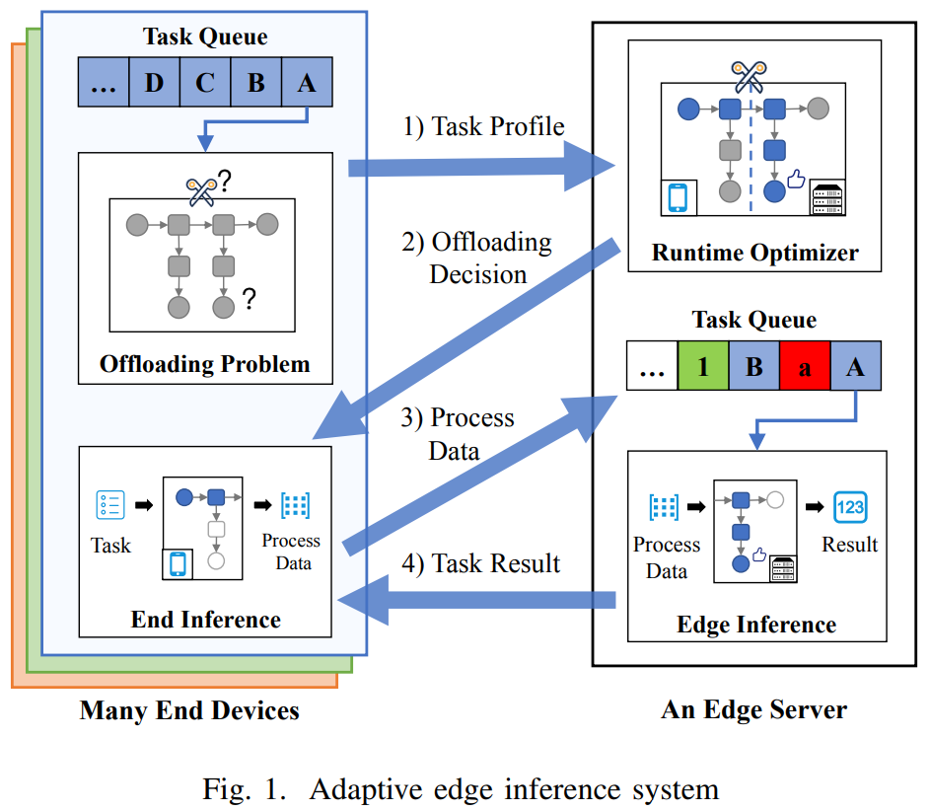
System Model
(1) workflow
- task stream input
- FCFS scheduling
3

Slide 5






System Model
(2) task model: a regression- based prediction model
$n^{th}task J_{n}=(D_{n},τ_{n}$, $t_{n}^{a})$,
$D_{n} input data size$
$τ_{n} max. latency$ $t_{n}^{a} task arrival time$
$$assume τ_{n}=k ∙ D_{n}, k ∈N$$
${exit point m}_{n}, 0≤m_{n}<u$
${partition point p}_{n}, 0≤p_{n}<l_{m_{n}}$
$u number of branches$
$l_{m_{n}} number of layers$
$prediction processing time f_{i, j}^{d}\left(D_{n}\right), d ∈\{0, 1\}$
$prediction output data size f_{i, j}^{d}\left(D_{n}\right), d=2$
4

Slide 6
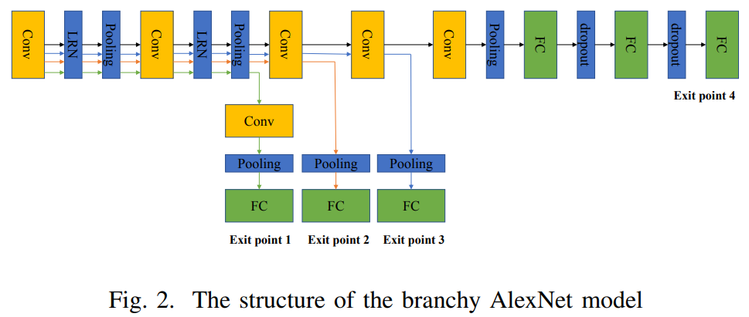
System Model
- branchy model
5

Slide 7










System Model
(3) computation model
${processing time t}_{n}^{end}=\sum_{i=1}^{p_{n}}{f_{m_{n}, i}^{0}\left(D_{n}\right)} on the end device$
${processing time t}_{n}^{edge}=\sum_{i=p_{n}+1}^{l_{m_{n}}}{f_{m_{n}, i}^{1}\left(D_{n}\right)} on the edge server$
${transmission time t}_{n}^{tr}=\frac{f_{m_{n},p_{n}}^{2}\left(D_{n}\right)}{ω}=\frac{output data size}{transmision rate}$
$$end device start process$$
$$end device start transmit$$
$$edge server start process$$
$$edge server finish process$$
6

Slide 8
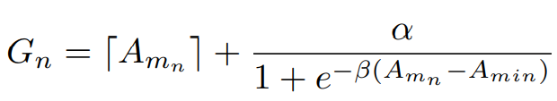







System Model
$gain function$
$min. inference accuracy$
$performance improvement factor$
$hyper−parameter for tuning acc.$
7

Slide 9
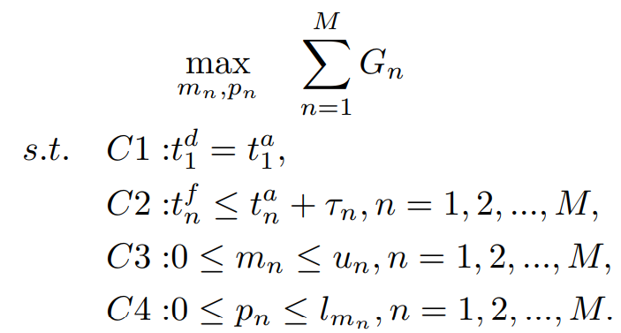





System Model
- problem formulation
$$total processing time$$
$$initialization$$
$$latency constrain$$
$$exit point$$
$$partition point$$
8

Slide 10
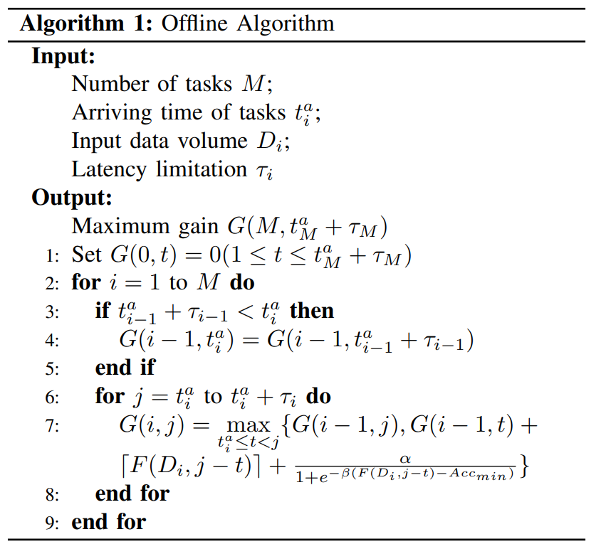
Problem Solution
1. Offline DP Algorithm
9

Slide 11
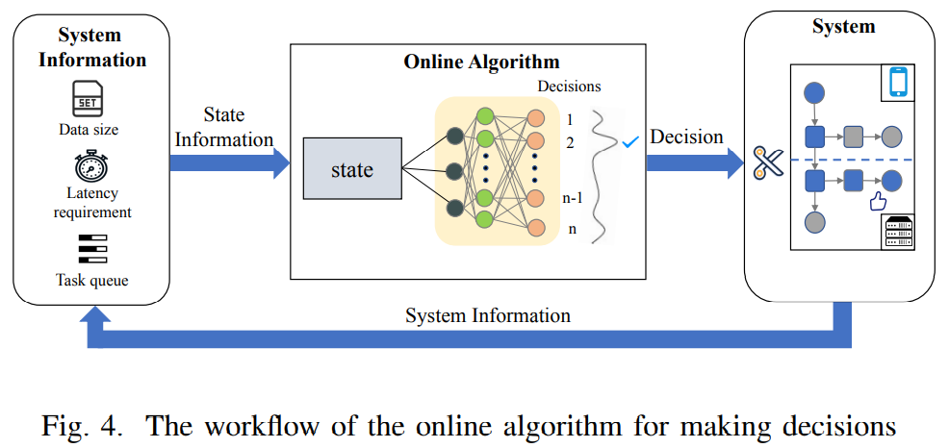
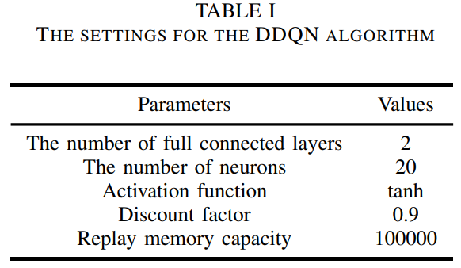
Problem Solution
2. Online DDQN Algorithm[1]
[1] Hado Van Hasselt, Arthur Guez, and David Silver. Deep reinforcement learning with double q-learning. 2015.
10

Slide 12
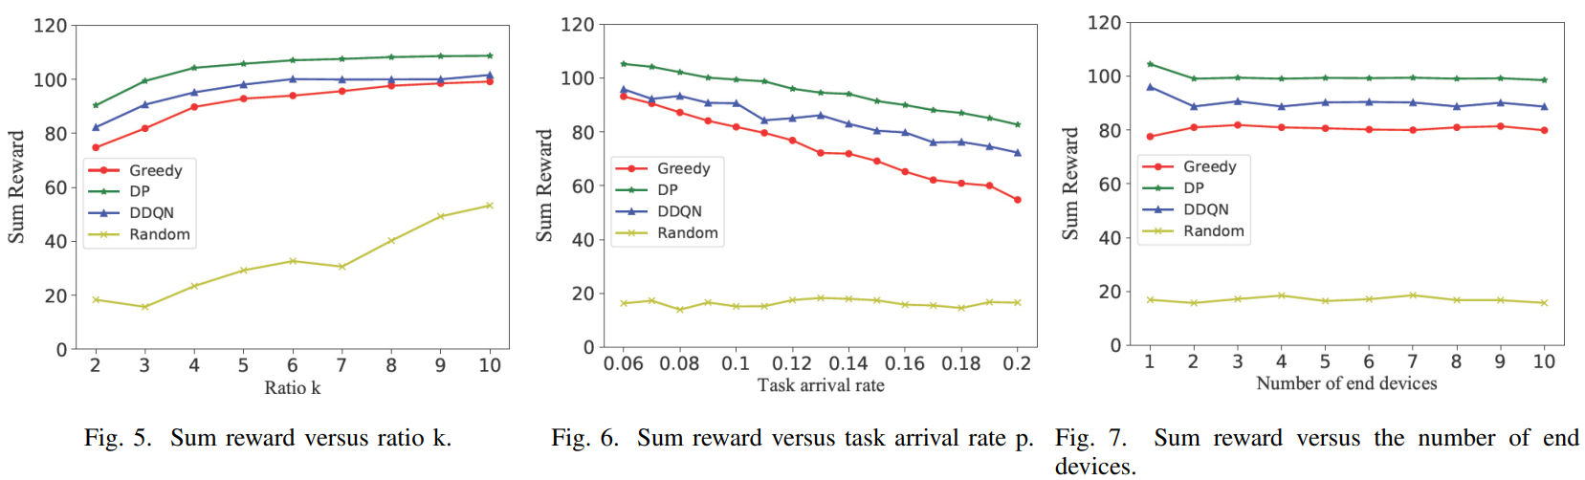
Simulation
– larger k indicates the task can be processed for a longer time
11

